Slide 1

CSE 464 : Software Quality Assurance and Testing
Structural (code-based) Based Testing - III
Data Path Testing
Janaka Balasooriya

Slide 2
Floating Point Calculations

Slide 3

Floating point error
Comparison of Floating-Point Numbers
  Floating-point numbers have limited precision
  Round-off errors can lead to unexpected results
double r = Math.sqrt(2.0);
if (r * r == 2.0)
{
System.out.println("Math.sqrt(2.0) squared is 2.0");
}
else
{
System.out.println("Math.sqrt(2.0) squared is not 2.0
but " + r * r);
}
Output:
Math.sqrt(2.0) squared is not 2.0 but 2.00000000000000044

Slide 4

The use of EPSILON
Use a very small value to compare the difference if floating-point values are ‘close enough’
  The magnitude of their difference should be less than some threshold
  Mathematically, we would write that x and y are close enough if:
final double EPSILON = 1E-14;
double r = Math.sqrt(2.0);
if (Math.abs(r * r - 2.0) < EPSILON)
{
System.out.println("Math.sqrt(2.0) squared is approx.
2.0");
}

Slide 5
DU-Path Testing

Slide 6
The Test Method Pendulum

Slide 7
Data Define-Use Path Testing
Basic path testing basically test the logical paths and decision making nodes.
D-U path testing focus on the data of the program.
A given program may use lots of data variables, data structures …etc
It is important that we generate test cases to test the correctness of modifications to data variables as the program is being executed.
D-U path testing investigates date flow in the program to uncover any bugs.
Notes:
7

Slide 8
D (definition)-U (use) Path Testing

Slide 9
What is D-U Path Testing
Definition (change of data stored in a variable):
  assignment statements ( x= y * z; defines x)
  declarations (int x = 56;, defines x)
  reading data from input devices ( cin>> x, defines x)
  … etc
Use (usage of the data stored in a variable):
    assignment statements ( x= y * z; uses y and z)
    output (cout<< x;)
    …etc

Slide 10
D-U path Example 1
public class simpleDataFlow {
public static int computations(int x , int y)
{
  int z = 0;
    if(x > 0)
    {
      z = x + y;
      x=0;
    }else
    {
      z = x - y;
      y=0;
    }
  return z;
}

Slide 11
In-class activity
Data-Flow Testing for IsValidMod10 Function
Notes:
11

Slide 12
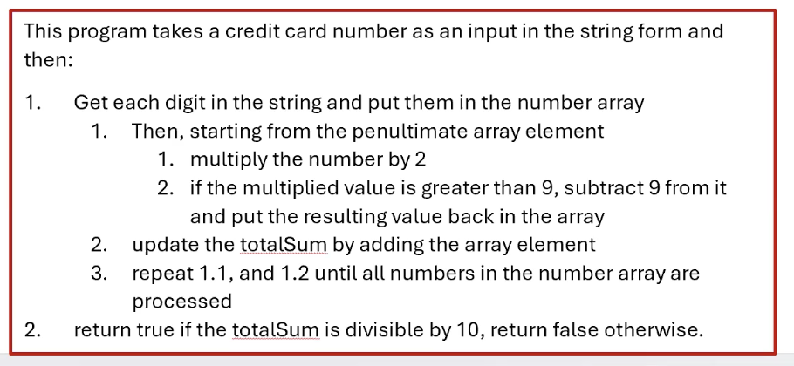
public static boolean IsValidMod10Number(String number)
{
int [] numberArray = new int[number.length()];
boolean checkBit = false;
int sumTotal =0;
for(int i=0; i < number.length() ; i++)
{
numberArray[i] = (int) number.charAt(i);
}
for(int index = numberArray.length -1 ; index >= 0 ; index--)
{
if(checkBit)
{
numberArray[index] *=2;
if(numberArray[index] > 9)
{
numberArray[index] -= 9;
}
}
sumTotal += numberArray[index];
checkBit = !checkBit;
}
return sumTotal % 10 ==0;
}

Slide 13
Data-Flow Testing for IsValidMod10 Function
Discussion
Notes:
13

Slide 14
Another Example Data-Flow – Stats
public static void computeStats (int [ ] numbers)
{
int length = numbers.length;
double med, var, sd, mean, sum, varsum;
sum = 0.0;
for (int i = 0; i < length; i++)
{
sum += numbers [ i ];
}
med = numbers [ length / 2 ];
mean = sum / (double) length;
varsum = 0.o;
for (int i = 0; i < length; i++)
{
varsum = varsum + ((numbers [ i ] - mean) * (numbers [ i ] - mean));
}
var = varsum / ( length - 1 );
sd = Math.sqrt ( var );
System.out.println ("length: " + length);
System.out.println ("mean: " + mean);
System.out.println ("median: " + med);
System.out.println ("variance: " + var);
System.out.println ("standard deviation: " + sd);
}
Reference: Introduction to Software Testing, © Ammann & Offutt

Slide 15
Control Flow Graph for Stats
( numbers )
sum = 0
length = numbers.length
1
2
i = 0
3
i >= length
i < length
med = numbers [ length / 2 ]
mean = sum / (double) length
varsum = 0
i = 0
4
5
sum += numbers [ i ]
i++
6
i >= length
i < length
var = varsum / ( length - 1.0 )
sd = Math.sqrt ( var )
print (length, mean, med, var, sd)
7
8
varsum = …
i++

Slide 16
CFG for Stats – With Defs & Uses
1
def (1) = { numbers, sum, length }
2
def (2) = { i }
3
use (3, 5) = { i, length }
use (3, 4) = { i, length }
4
5
def (5) = { med, mean, varsum, i }
use (5) = { numbers, length, sum }
def (4) = { sum, i }
use (4) = { sum, numbers, i }
6
use (6, 8) = { i, length }
use (6, 7) = { i, length }
def (8) = { var, sd }
use (8) = { varsum, length, mean,
med, var, sd }
7
8
def (7) = { varsum, i }
use (7) = { varsum, numbers, i, mean }

Slide 17
Defs and Uses Tables for Stats
Node | Def | Use
1 | { numbers, sum, length } | { numbers }
2 | { i }
3 |  | {i, length}
4 | { sum, i } | { numbers, i, sum }
5 | { med, mean, varsum, i } | { numbers, length, sum }
6
7 | { varsum, i } | { varsum, numbers, i, mean }
8 | { var, sd } | { varsum, length, var, mean, med, var, sd }

Slide 18
DU Pairs for Stats
variable | DU Pairs
numbers | (1, 4) (1, 5) (1, 7)
length | (1, 5) (1, 8) (1, (3,4)) (1, (3,5)) (1, (6,7)) (1, (6,8))
med | (5, 8)
var | (8, 8)
sd | (8, 8)
mean | (5, 7) (5, 8)
sum | (1, 4) (1, 5) (4, 4) (4, 5)
varsum | (5, 7) (5, 8) (7, 7) (7, 8)
i | (2, 4) (2, (3,4)) (2, (3,5)) (2, 7) (2, (6,7)) (2, (6,8)) (4, 4) (4, (3,4)) (4, (3,5)) (4, 7) (4, (6,7)) (4, (6,8)) (5, 7) (5, (6,7)) (5, (6,8)) (7, 7) (7, (6,7)) (7, (6,8))

Slide 19
DU Paths for Stats
variable | DU Pairs | DU Paths
numbers | (1, 4) (1, 5) (1, 7) | [ 1, 2, 3, 4 ] [ 1, 2, 3, 5 ] [ 1, 2, 3, 5, 6, 7 ]
length | (1, 5) (1, 8) (1, (3,4)) (1, (3,5)) (1, (6,7)) (1, (6,8)) | [ 1, 2, 3, 5 ] [ 1, 2, 3, 5, 6, 8 ] [ 1, 2, 3, 4 ] [ 1, 2, 3, 5 ] [ 1, 2, 3, 5, 6, 7 ] [ 1, 2, 3, 5, 6, 8 ]
med | (5, 8) | [ 5, 6, 8 ]
var | (8, 8) | No path needed
sd | (8, 8) | No path needed
sum | (1, 4) (1, 5) (4, 4) (4, 5) | [ 1, 2, 3, 4 ] [ 1, 2, 3, 5 ] [ 4, 3, 4 ] [ 4, 3, 5 ]
variable | DU Pairs | DU Paths
mean | (5, 7) (5, 8) | [ 5, 6, 7 ] [ 5, 6, 8 ]
varsum | (5, 7) (5, 8) (7, 7) (7, 8) | [ 5, 6, 7 ] [ 5, 6, 8 ] [ 7, 6, 7 ] [ 7, 6, 8 ]
i | (2, 4) (2, (3,4)) (2, (3,5)) (4, 4) (4, (3,4)) (4, (3,5)) (5, 7) (5, (6,7)) (5, (6,8)) (7, 7) (7, (6,7)) (7, (6,8)) | [ 2, 3, 4 ] [ 2, 3, 4 ] [ 2, 3, 5 ] [ 4, 3, 4 ] [ 4, 3, 4 ] [ 4, 3, 5 ] [ 5, 6, 7 ] [ 5, 6, 7 ] [ 5, 6, 8 ] [ 7, 6, 7 ] [ 7, 6, 7 ] [ 7, 6, 8 ]

Slide 20
DU Paths for Stats – No Duplicates
There are 38 DU paths for Stats, but only 12 unique
[ 1, 2, 3, 4 ]
[ 1, 2, 3, 5 ]
[ 1, 2, 3, 5, 6, 7 ]
[ 1, 2, 3, 5, 6, 8 ]
[ 2, 3, 4 ]
[ 2, 3, 5 ]
[ 4, 3, 4 ]
[ 4, 3, 5 ]
[ 5, 6, 7 ]
[ 5, 6, 8 ]
[ 7, 6, 7 ]
[ 7, 6, 8 ]
4 expect a loop not to be “entered”
6 require at least one iteration of a loop
2 require at least two iterations of a loop

Slide 21
Test Cases and Test Paths
Test Case : numbers = (44) ; length = 1
Test Path : [ 1, 2, 3, 4, 3, 5, 6, 7, 6, 8 ]
Additional DU Paths covered (no sidetrips)
[ 1, 2, 3, 4 ] [ 2, 3, 4 ] [ 4, 3, 5 ] [ 5, 6, 7 ] [ 7, 6, 8 ]
The five stars that require at least one iteration of a loop
Test Case : numbers = (2, 10, 15) ; length = 3
Test Path : [ 1, 2, 3, 4, 3, 4, 3, 4, 3, 5, 6, 7, 6, 7, 6, 7, 6, 8 ]
DU Paths covered (no sidetrips)
[ 4, 3, 4 ] [ 7, 6, 7 ]
The two stars that require at least two iterations of a loop
Other DU paths require arrays with length 0 to skip loops
But the method fails with index out of bounds exception…
med = numbers [length / 2];
A fault was
found

